Slide 2
Introduction to
Data Science
(IT4142E)

Slide 3
Contents
Lecture 1: Overview of Data Science
Lecture 2: Data crawling and preprocessing
Lecture 3: Data cleaning and integration
Lecture 4: Exploratory data analysis
Lecture 5: Data visualization
Lecture 6: Multivariate data visualization
Lecture 7: Machine learning
Lecture 8: Big data analysis
Lecture 9: Capstone Project guidance
Lecture 10+11: Text, image, graph analysis
Lecture 12: Evaluation of analysis results

Slide 4
This lecture
How to choose the right chart?
Bar Chart – Column Chart
Line Chart
Histogram
Scatter Plot
Violin
Other charts
Multivariable Visualization

Slide 5
1. How to choose the right chart?
Data visualization is a technique to communicate insights from data through visual representation
Main goal: is to distill large datasets into visual graphics to allow for a straighforward understanding of complex relationship within the data
It is important to choose the right chart for visualizing your data

Slide 6
What story do you want to tell?
It is important to understand why we need a kind of chart
Graphs
Plots
Maps
Diagrams
...
Relationship
Data over time
Ranking
Distribution
Comparison

Slide 7
Relationship
To display a connection or correlation between two or more variables
When assessing a relationship between data sets, we are trying to understand how these data sets combine and interact with each other
The relationship or correlation can be positive or negative
Whether or not the variables might be supportive or working against each other

Slide 8
Relationship
Scatter plot
Histogram
Pair Plot
Heat map

Slide 9
Data over time
Goal: to explore the relationship between variables to find trends or changes over time
The date/time appears as a link property between variables, so a kind of relationship
Line chart
Area chart
Stack Area Chart
Area Chart Unstacked

Slide 10
Ranking
Goal: to display the relative order of data values
Vertical bar chart
Horizontal bar chart or Column Chart
Multi-set bar chart
Stack bar chart
Lollipop Chart

Slide 11
Distribution
Goal: to see how a variable is distributed
Histogram
Density Curve with Histogram
Density plot
Box plot
Strip plot
Violin Plot
Population Pyramid

Slide 12
Comparison
Goal: to display the trends between multiple variable in datasets or multiple categories within a single variable
Bubble chart
Bullet chart
Pie chart
Net pie chart
Donut chart
TreeMap
Diverging bar
Choropleth map
Bubble map

Slide 13
2. Bar/Column Chart
A series of bars illustrating a variable’s development
4 types of bar charts:
Horizontal bar chart
Vertical bar chart
Group bar chart
Stacked bar chart
This kind of chart is appropriated when we want to track the development of one or two variables over time
One axis shows the specific categories being compared (independent variable)
The other axis represents a measured value (dependent variable)

Slide 14
Vertical Bar Chart (Column Chart)
Distinguish it from histograms
not to display a continuous developments over an interval
discrete data
data is categorical and used to answer the question of how many in each category
Used to compare several items in a specific range of values
Ideal for comparing a single category of data between individual sub-items

Slide 15
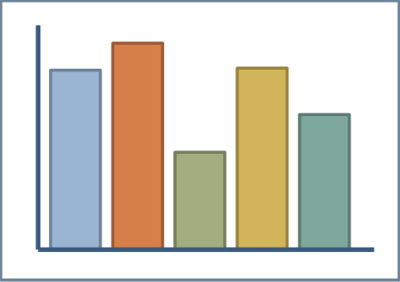
Vertical Bar Chart (Column Chart)
Benefits from both position (top of bar)
and length (size of bar)
Quantitative
Dependent
variable
Discrete/Nominal
Independent variable

Slide 16
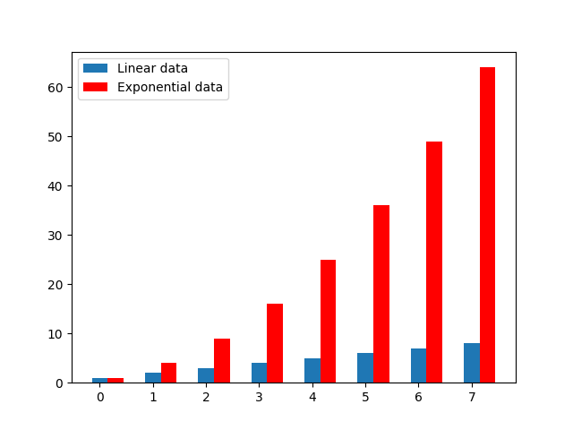
Vertical Bar Chart (Column Chart)
import numpy as np import matplotlib.pyplot as plt linear_data = np.array([1, 2, 3, 4, 5, 6, 7, 8]) exponential_data = linear_data ** 2 xvals = range(len(linear_data)) plt.bar(xvals, linear_data, width=0.3) exp_xvals = [] for item in xvals: exp_xvals.append(item+0.3) plt.bar(exp_xvals, exponential_data, width=0.3, color='r') plt.legend(['Linear data', 'Exponential data']) plt.show()

Slide 17

Vertical Bar Chart (Column Chart)
import numpy as np import matplotlib.pyplot as plt linear_data = np.array([1, 2, 3, 4, 5, 6, 7, 8]) exponential_data = linear_data ** 2 xvals = np.arange(len(linear_data)) exp_xvals = [] for item in xvals: exp_xvals.append(item+0.3) fig, ax = plt.subplots() ax.bar(xvals, linear_data, width=0.3) ax.bar(exp_xvals, exponential_data, width=0.3, color='r') ax.legend(['Linear data', 'Exponential data']) ax.set_xticks(xvals + 0.3 / 2) ax.set_xticklabels(xvals) plt.show()

Slide 18
Horizontal Bar Chart
Represent the data horizontally
The data categories are shown on the y-axis
The data values are shown on the x-axis
The length of each bar is equal to the value corresponding to the data category
All bars go across from left to right
Use barh() function

Slide 19
Stacked Bar Chart
Stacked bar charts segment their bars
Used to show how a broader category is divided into smaller categories
The relationship of each part on the total amount is also showed
Place each value for the segment after the previous one
The total value of the bar chart is all the segment values added together
Ideal for comparing the total amount across each group/segmented bar

Slide 20
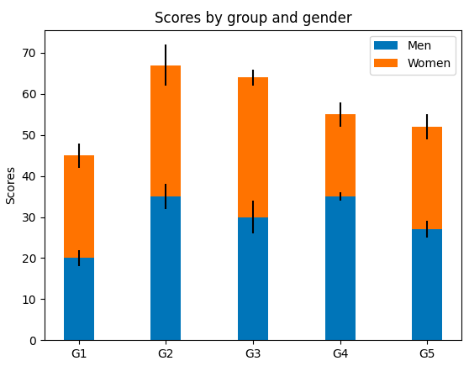
Stacked Bar Chart

Slide 21
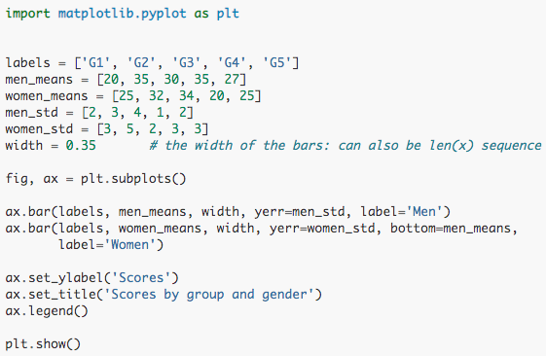
Stacked Bar Chart

Slide 22
3. Line Chart
Line charts are used to display quantitative values over a continuous interval or period
Drawn by first plotting data points on a cartesian coordinate grid and then connecting them
Y-axis has a quantitative value
X-axis is a timescale or a sequence of intervals
Best for continuous data
Most frequently used to show trends and analyze how the data has changed over time

Slide 23
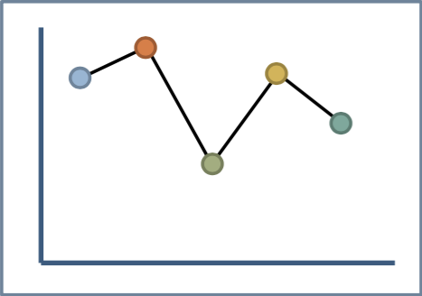
Line charts
Quantitative continuous
dependent
variable
Benefits from
position but not length
Quantitative continuous
independent variable

Slide 24
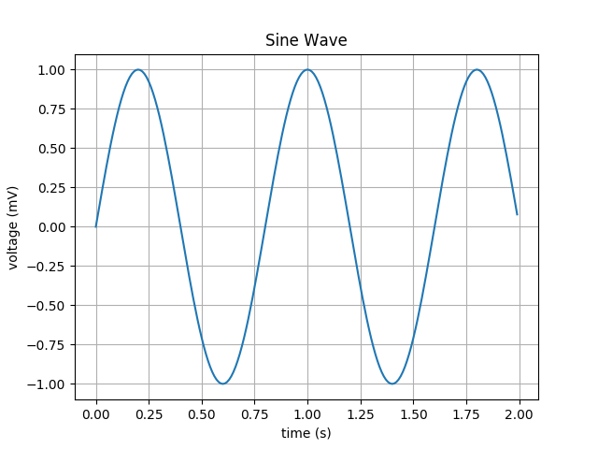
Line chart (pylab vs pyplot
from pylab import * t = arange(0.0, 2.0, 0.01) s = sin(2.5*pi*t) plot(t,s) xlabel('time (s)') ylabel('voltage (mV)') title('Sine Wave') grid(True) show()
import numpy as np import matplotlib.pyplot as plt t = np.arange(0.0, 2.0, 0.01) s = np.sin(2.5*np.pi*t) plt.plot(t,s) plt.xlabel('time (s)') plt.ylabel('voltage (mV)') plt.title('Sine Wave') plt.grid(True) plt.show()

Slide 25
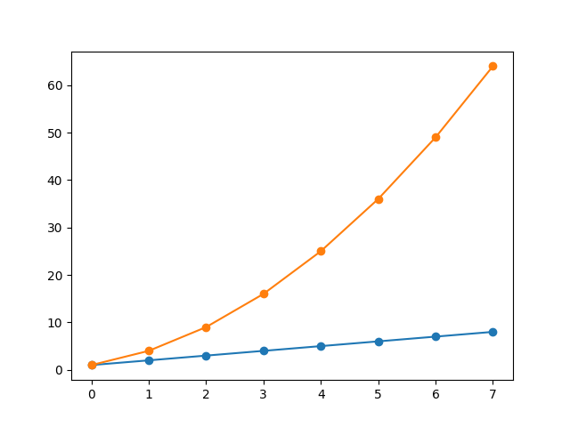
Line chart (cont.)
import numpy as np import matplotlib.pyplot as plt linear_data = np.array([1,2,3,4,5,6,7,8]) exponential_data = linear_data**2 plt.plot(linear_data, '-o', exponential_data, '-o') plt.show()

Slide 26
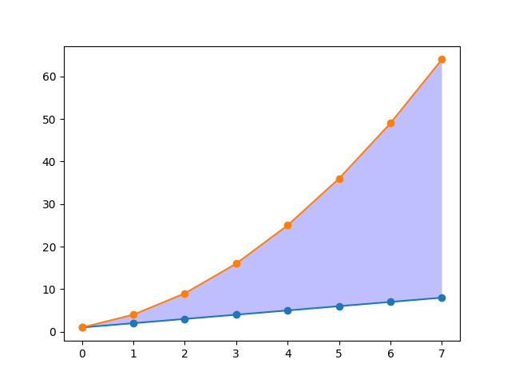
Line chart (cont.)
import numpy as np import matplotlib.pyplot as plt linear_data = np.array([1,2,3,4,5,6,7,8]) exponential_data = linear_data**2 plt.plot(linear_data, '-o', exponential_data, '-o')
plt.gca().fill_between(range(len(linear_data)), linear_data, exponential_data, facecolor='blue', alpha=0.25) plt.show()

Slide 27
Area Chart
Built based on line chart
The area between the x-axis and the line is filled in with color or shading
Ideal for clearly illustrating the magnitude of change between two or more data points
Use stackplot() function
Or just fill in color the area between two lines

Slide 28
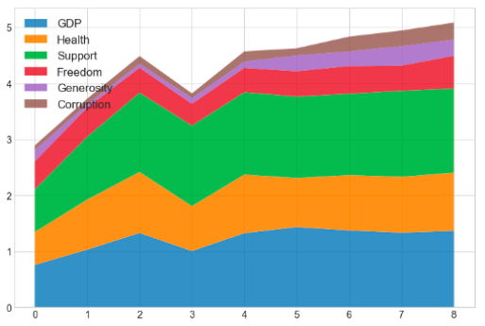
Area Chart

Slide 29
4. Histogram
Histogram is an accurate representation of the distribution of numerical data
An estimation of the probability distribution of a continuos variable
To construct a histogram, follow these steps
Bin the range of values
Divide the entire range of values into a series of intervals
Count how many values fall into each interval
Bins are usually specified as consecutive, non-overlapping intervals of variable

Slide 30
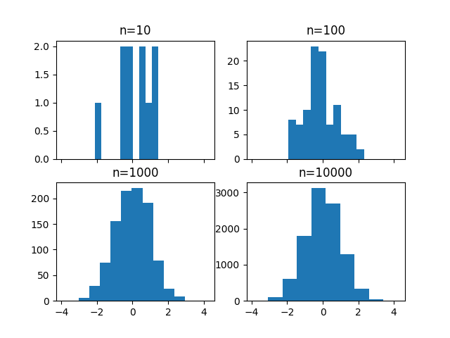
Histogram example

Slide 31
Histogram example
import numpy as np import matplotlib.pyplot as plt fig, ((ax1, ax2), (ax3, ax4)) = plt.subplots(2,2, sharex=True) axs = [ax1, ax2, ax3, ax4] for n in range(0, len(axs)): sample_size = 10**(n+1) sample = np.random.normal(loc=0.0, scale=1.0, size=sample_size) axs[n].hist(sample) axs[n].set_title('n={}'.format(sample_size)) plt.show()

Slide 32
Histogram example
import numpy as np import matplotlib.pyplot as plt fig, ((ax1, ax2), (ax3, ax4)) = plt.subplots(2,2, sharex=True) axs = [ax1, ax2, ax3, ax4] for n in range(0, len(axs)): sample_size = 10**(n+1) sample = np.random.normal(loc=0.0, scale=1.0, size=sample_size) axs[n].hist(sample, bins=100) axs[n].set_title('n={}'.format(sample_size)) plt.show()

Slide 33
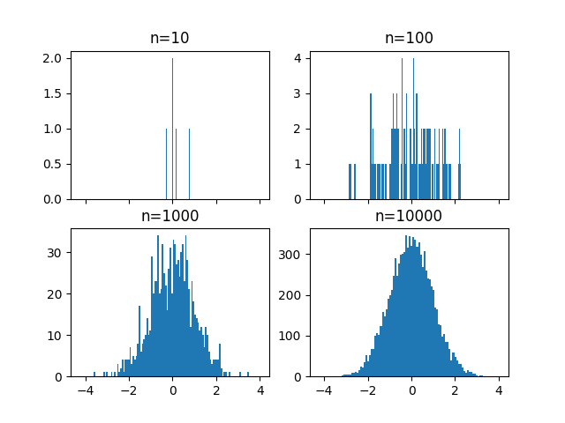
Histogram example

Slide 34
5. Scatter plot
A kind of chart that is often used in statistics and data science
It consists of multiple data points plotted across two axes
Each variable depicted in a scatter plot would have various observations
Used to identify the data’s relationship with each variable (i.e., correlation, trend patterns)
In machine learning, scatter plots are often used in regression, where x and y are continuous variable
Also being used in clustering scatters or outlier detection

Slide 35
Practice with Pandas and Seaborn to manipulating data
import pandas as pd import seaborn as sns import matplotlib.pyplot as plt iris = pd.read_csv("../input/Iris.csv")
iris.head()
Import the dataset Iris

Slide 36
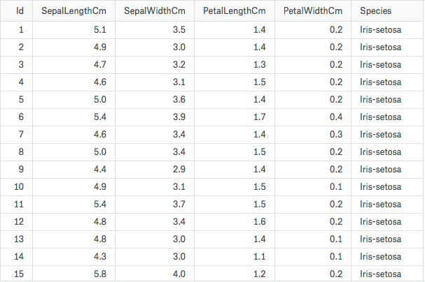
Practice with Pandas and Seaborn to manipulating data

Slide 37
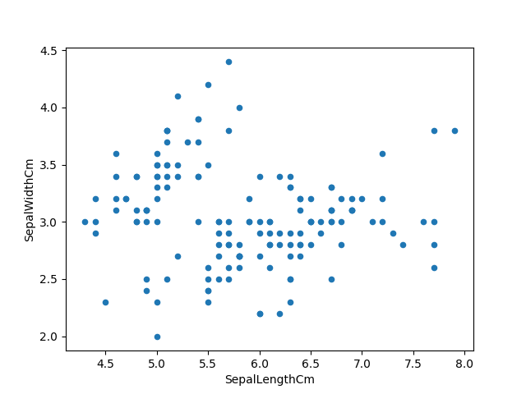
Use scatter plot for Iris data
Plot two variables: SepalLengthCm and SepalWidthCm
import pandas as pd import seaborn as sns import matplotlib.pyplot as plt iris = pd.read_csv("../input/Iris.csv") iris.head() iris["Species"].value_counts() iris.plot(kind="scatter", x="SepalLengthCm", y="SepalWidthCm") plt.show()

Slide 38
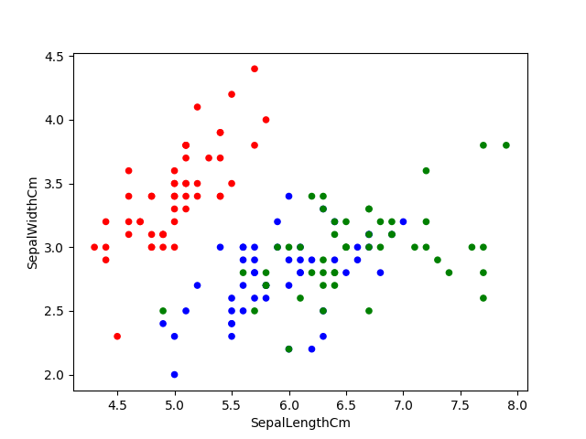
Use scatter plot for Iris data
Display color for each kind of Iris
import pandas as pd import seaborn as sns import matplotlib.pyplot as plt iris = pd.read_csv("../input/Iris.csv") iris.head() iris["Species"].value_counts() col = iris['Species'].map({"Iris-setosa":'r', "Iris-virginica":'g', "Iris-versicolor":'b'}) iris.plot(kind="scatter", x="SepalLengthCm", y="SepalWidthCm", c=col) plt.show()

Slide 39
Marginal Histogram
Histograms added to the margin of each axis of a scatter plot for analyzing the distribution of each measure
Assess the relationship between two variables and examine their distributions

Slide 40
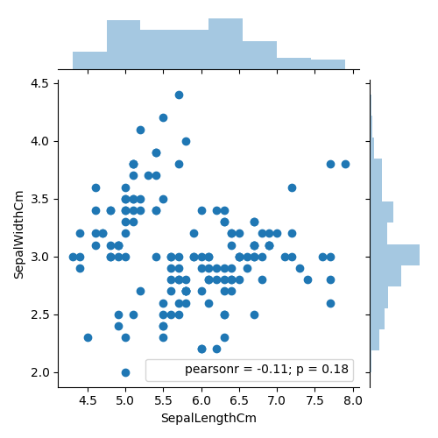
Marginal Histogram
import pandas as pd import seaborn as sns import matplotlib.pyplot as plt iris = pd.read_csv("../input/Iris.csv") iris.head() iris["Species"].value_counts() sns.jointplot(x="SepalLengthCm", y="SepalWidthCm", data=iris, size=5) plt.show()

Slide 41
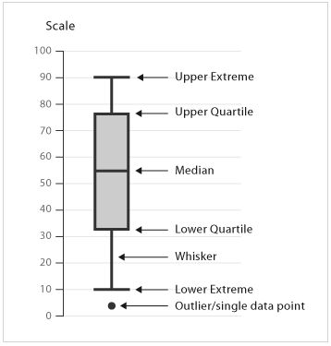
6. Other kinds of chart Box Plot
Box and Whisker Plot (or Box Plot) is a convenient way of visually displaying the data distribution through their quartiles

Slide 42
Box Plot
Some observations from viewing Box Plot
What the key values are such as: the average, median, 25th percentile etc.
If there are any outliers and what their values are
Is the data symmetrical
How tightly is the data grouped
If the data is skewed and if so, in what direction

Slide 43
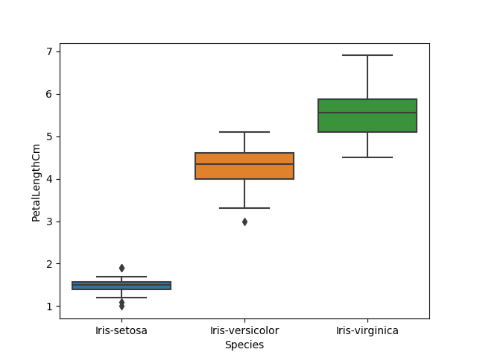
Box Plot
import pandas as pd import seaborn as sns import matplotlib.pyplot as plt iris = pd.read_csv("../input/Iris.csv") iris.head() sns.boxplot(x="Species", y="PetalLengthCm", data=iris) plt.show()

Slide 44

Box Plot
import pandas as pd import seaborn as sns import matplotlib.pyplot as plt iris = pd.read_csv("../input/Iris.csv") iris.head() ax = sns.boxplot(x="Species", y="PetalLengthCm", data=iris) ax = sns.stripplot(x="Species", y="PetalLengthCm", data=iris, jitter=True, edgecolor="gray")
plt.show()

Slide 45
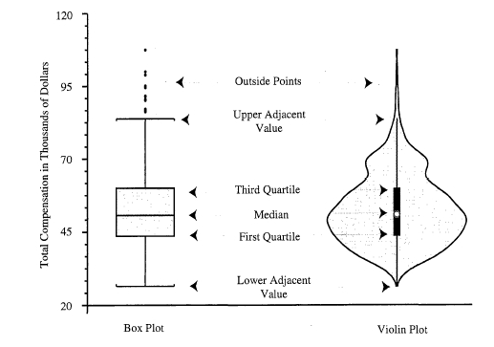
Violin Plot
Combination of the box plot with a kernel density plot
Same information from box plot

Slide 46
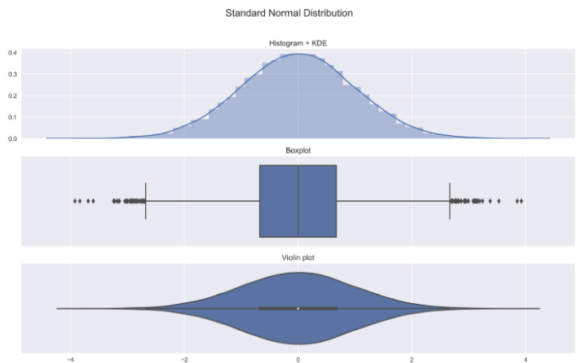
Violin Plot
Shows the entire distribution of the data

Slide 47
Violin Plot
Histogram shows the symmetric shape of the distribution

Slide 48
Violin Plot
The kernel density plot used for creating the violin plot is the same as the one added on top of the histogram

Slide 49
Violin Plot
Wider sections of the violin plot represent a higher probability of observations taking a given value
The thinner sections correspond to a lower probability.

Slide 50
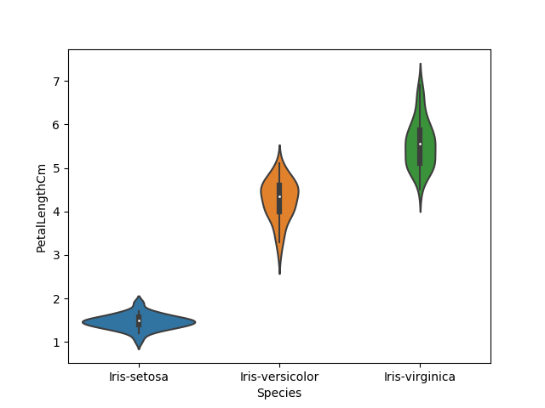
Violin Plot of Iris data
import pandas as pd import seaborn as sns import matplotlib.pyplot as plt iris = pd.read_csv("../input/Iris.csv") iris.head() sns.violinplot(x="Species", y="PetalLengthCm", data=iris, size=6)
plt.show()

Slide 51
Regression Plot
Create a regression line between 2 parameters and helps to visualize their linear relationships
Example: data set tips of seaborn contains information about:
the people who probably had food at the restaurant and whether or not they left a tip
the gender of the people, whether they smoke, day, time
Use seaborn’s function lmplot() to create regression plot

Slide 52
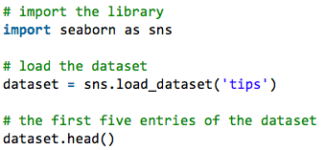
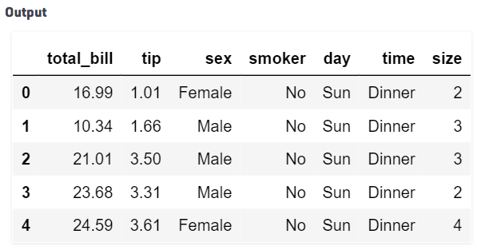
Regression Plot example

Slide 53
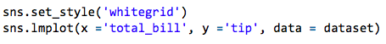
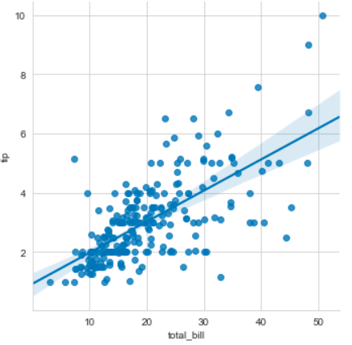
Regression Plot Example
Show the linear relationship betweet the total bill of customers and the tips they gave

Slide 54
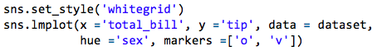
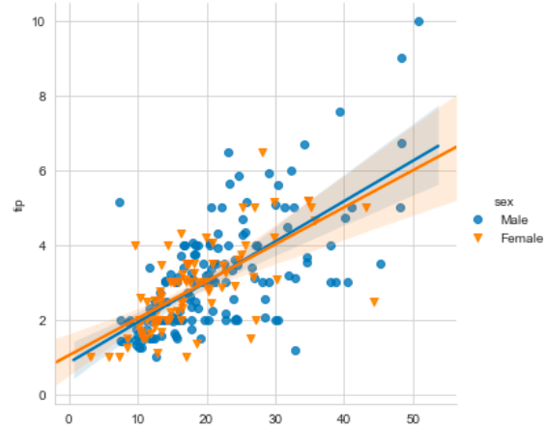
Regression Plot Example
Distinguish two categories by sex

Slide 55
Heatmaps
The underlying idea: replace numbers with colors
The goal of heatmaps is to provide a colored visual summary of information
Heatmaps are useful for cross-examining multivariate data, through placing variables in rows and columns and coloring cells within the table
All the rows are one category (labels displayed on the left side)
All the columns are another category (labels displayed on the bottom)
Data in a cell demonstrates the relationship between two variables in the connecting row and column

Slide 56
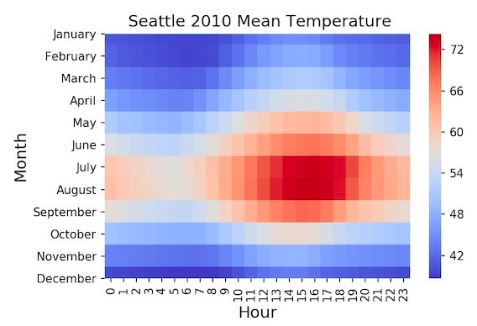
Heatmap Example

Slide 57
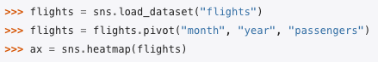
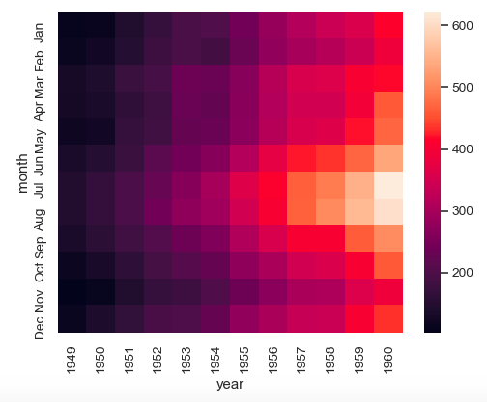
Heatmap with seaborn

Slide 58
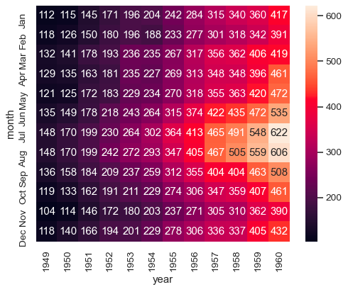
Heatmap with seaborn

Slide 59
Graphs
edge
node

Slide 60
Graphs
edge
node
If we add this edge then this would be a complete graph, also called a clique

Slide 61
Directed Graphs and Hierarchies
Directed vs Undirected
Cyclic vs acyclic
Tree
Minimally connected
N nodes, n-1 edges
Single parent node can have multiple child nodes
Hierarchy
Acyclic directed graph
Having a root node

Slide 62
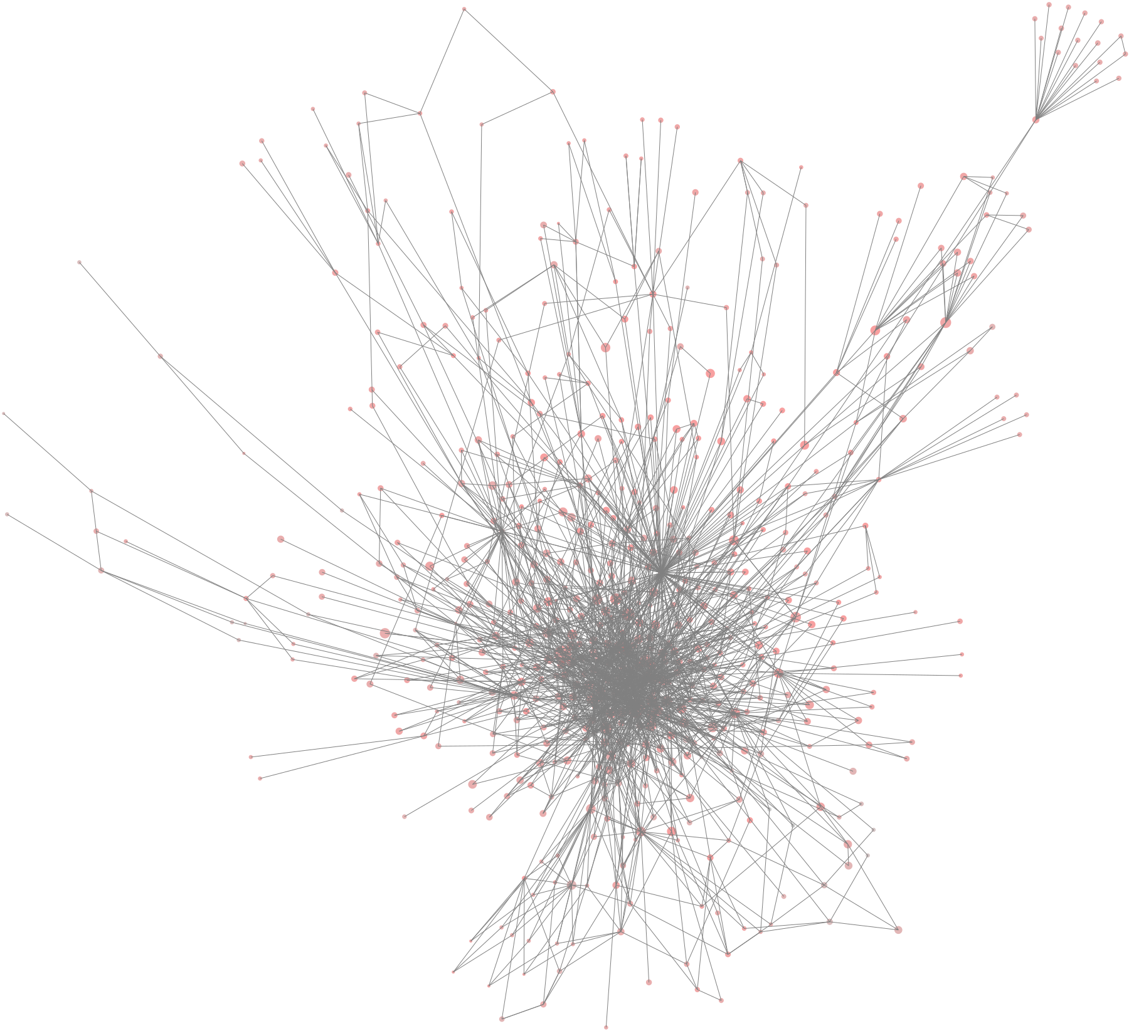
Node Degree
Degree of a node = number of edges
Directed graph nodes have an in-degree and an out-degree
Social Networks
Many low degree nodes and fewer high degree nodes
Also called power-law or scale-free graphs

Slide 63
Graph Visualization
For visualizing more abstract and non-quantitative data
For example:
The relationship/contacts of individuals in a population (also called network of contacts)
The hierarchical structure of classes in a module
Matplotlib does not support this kind of visualization

Slide 64
Roassal: an agile visualization tool
Roassal is a DSL, written in Smalltalk and integrated in Pharo/Moose – an open source platform for software and data analysis
Installing from: http://www.moosetechnology.org

Slide 65
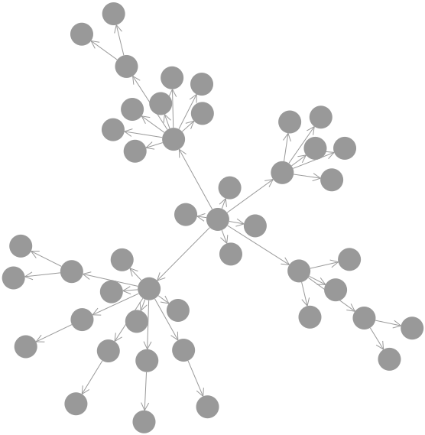
Hierarchy
| b |
b := RTMondrian new.
b shape circle size: 30.
b nodes: RTShape withAllSubclasses.
b shape arrowedLine withShorterDistanceAttachPoint.
b edgesFrom: #superclass.
b layout forceWithCharge: -500.
b build.
^ b view
Notes:
The hierarchical structure of the class RTShape and all its subclasses

Slide 66
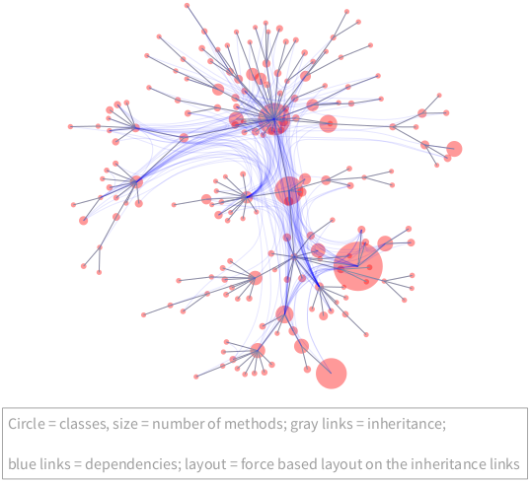
Network structure
| b lb |
b := RTMondrian new.
b shape circle color: (Color red alpha: 0.4).
b nodes: Collection withAllSubclasses.
b edges connectFrom: #superclass.
b shape
bezierLineFollowing: #superclass;
color: (Color blue alpha: 0.1).
b edges
notUseInLayout;
connectToAll: #dependentClasses.
b normalizer normalizeSize: #numberOfMethods min: 5 max: 50.
b layout force.
b build.
lb := RTLegendBuilder new.
lb view: b view.
lb addText: 'Circle = classes, size = number of methods; gray links = inheritance;'.
lb addText: 'blue links = dependencies; layout = force based layout on the inheritance links'.
lb build.
^ b view @ RTZoomableView

Slide 67
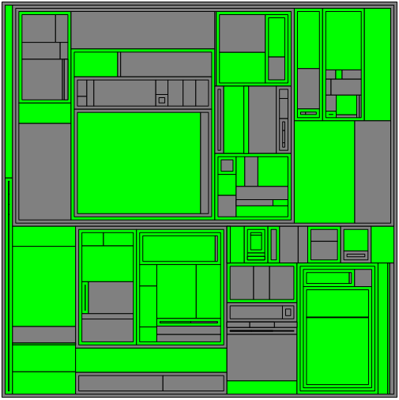
Tree Map
Maps quantities to area
Color used to differentiate areas
Shading delineates hierarchical regions
When to use?
Limited space but large amount of hierarchical data
Values can be aggregated in the tree structure
Advantages
Saving space, display a large number of item simultaneously
Using color and size of areas to detect special sample data
Notes:
Treemaps được sử dụng để hiển thị dữ liệu phân cấp
Chúng ta thường sử dụng treemaps khi không gian bị hạn chế và chúng ta có một số lượng lớn các dữ liệu phân cấp và cần có cái nhìn tổng quát về dữ liệu
Treemaps nên được sử dụng chủ yếu với các giá trị có thể tổng hợp được
Ưu điểm của treemaps:
Treemaps tiết kiệm được không gian biểu diễn và có thể hiển thị cùng lúc nhiều mục dữ liệu
Khi có mối tương quan giữa màu sắc và kích thước trong cấu trúc cây thì treemap giúp chúng ta dễ dàng phát hiện được các mẫu khác nhau căn cứ vào màu sắc và kích thước areas.

Slide 68
Tree map layout
1
2
1
1
1
2
2
1
1
1
1
1
1

Slide 69
Tree map layout
16
11
5
4
4
3
3
2
1
2
1
1
1
2
2
1
1
1
1
1
1
Set parents node values to sum of child node values from bottom up
Notes:
Đặt giá trị các parent node thành tổng các giá trị của node con từ dưới lên

Slide 70
Tree map layout
16
11
5
4
4
3
3
2
1
2
1
1
1
2
2
1
1
1
1
1
1
11/16
5/16
Set parents node values to sum of child node values from bottom up
Partition based on current node’s value as a portion of parent node’s value from top down
Notes:
Việc phân vùng trên treemap dựa trên giá trị của node hiện tại bằng cách chia vùng từ giá trị của node parent từ trên xuống dưới

Slide 71
Tree map layout
16
11
4/11
3/5
5
4
4
3
3
2
4/11
1
2
1
1
1
2
2
1
1
1
1
1
1
11/16
5/16
2/5
Set parents node values to sum of child node values from bottom up
Partition based on current node’s value as a portion of parent node’s value from top down
3/11
Notes:
Việc phân vùng trên treemap dựa trên giá trị của node hiện tại bằng cách chia vùng từ giá trị của node parent từ trên xuống dưới

Slide 72
Tree map layout
16
2/4
1/3
1/4
3/5
4/11
11
1/4
5
3
3
2
1/3
4
4
1/4
1/4
2/4
4/11
1/3
1
2
1
1
1
2
2
1
1
1
1
1
1
11/16
5/16
2/5
Set parents node values to sum of child node values from bottom up
Partition based on current node’s value as a portion of parent node’s value from top down
1/3
2/3
3/11
1/3
1/3
Notes:
Việc phân vùng trên treemap dựa trên giá trị của node hiện tại bằng cách chia vùng từ giá trị của node parent từ trên xuống dưới

Slide 73
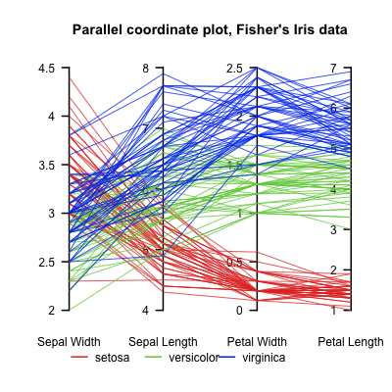
8. Multivariable Visualization
For data tables with n>3 variables: parallel coordinates
Each vertical line corresponds to a variable
A point in n-dimensional space is represented as a polyline with vertices on the parallel axes
the position of the vertex on the i-th axis corresponds to the value of the i-th attribute for this record
It might be interesting to try different axis arrangements

Slide 74
Parallel Plot
Parallel Coordinates Plots allow to compare the feature of several individual observations on a set of numerical variables
Each vertical bar represents a variable and usually has its own scale
Values are plotted as series of lines connected across each axis
Color can be used to represent different groups of individuals or highlight a specific one
Allow to compare variations of adjacent axis
Changing the order can lead to the discovery of new patterns in the dataset

Slide 75
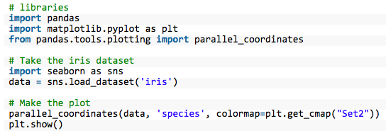
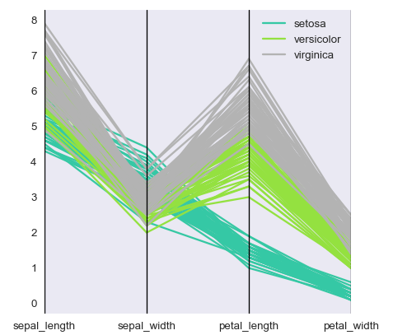
Parallel plot with pandans for Iris data
Samples are grouped in 3 species
Setosa seems have smaller petals but its sepal tends to be wider

